Slide 1
Facade design Pattern
Abdul haseeb 2021-SE-22

Slide 2
Gang of four design patterns
Set of solutions to commonly faced problems in software design and development
Composed of 23 design patterns
Further classified into 3 types
Creational Patterns
Structural Patterns
Behavioral Patterns

Slide 3
Facade pattern
Part of the Structural design patterns
Because it involves interface(s) and classes
Hides complexities of the system by providing a simple interface
Client knows nothing about the implementation details

Slide 4
When to use it?
System is difficult to understand
Reduce coupling through use of interface
Client has to be provided exposure in a simple way

Slide 5
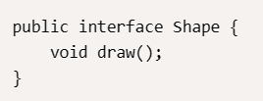
Example
1) Consider an interface: Shape

Slide 6
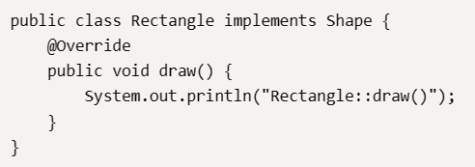
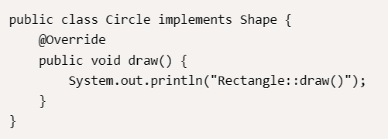
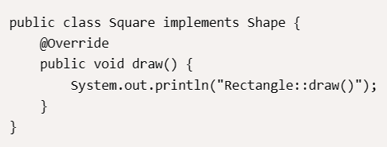
2) A couple of classes implementing said interface: Rectangle, Square, Circle

Slide 7
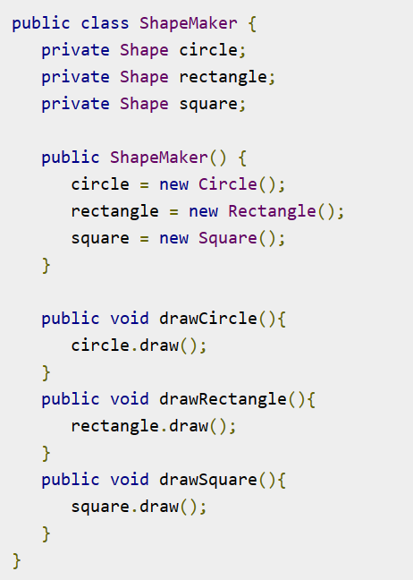
3) Create the facade class
[This is what the client accesses]

Slide 8
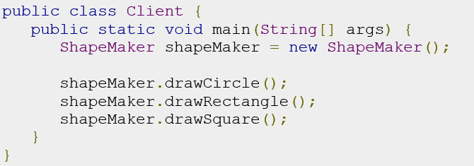
4) How client accesses the facade

Slide 9
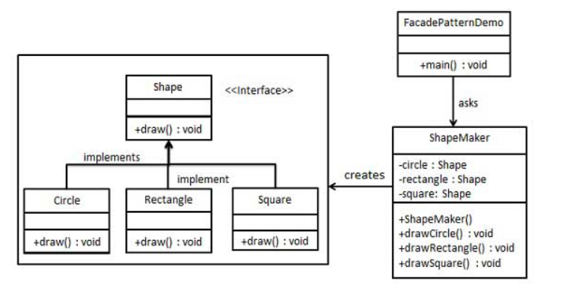
UML diagram(S)

Slide 10
